Slide 1
1) Files without emp

Slide 2
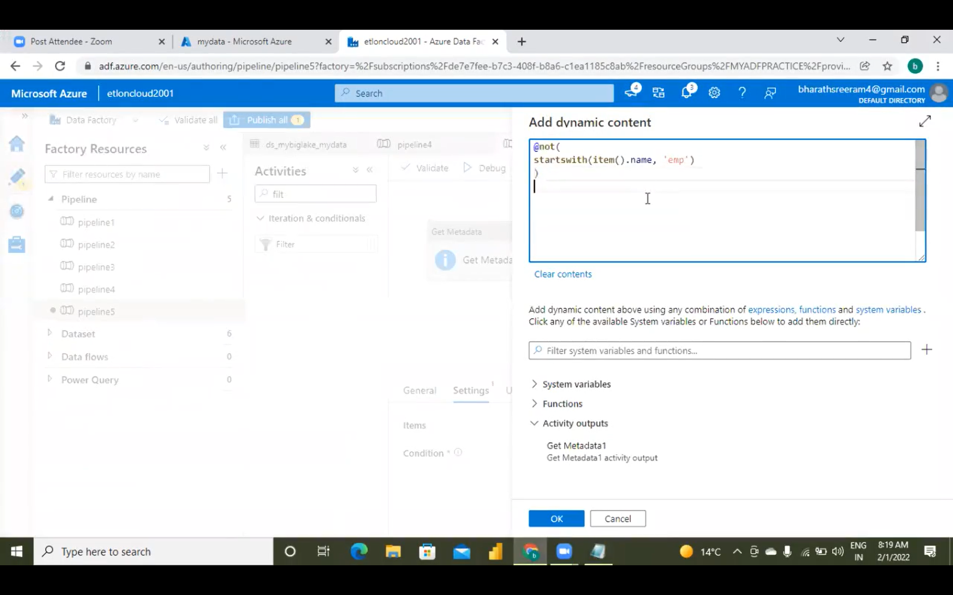
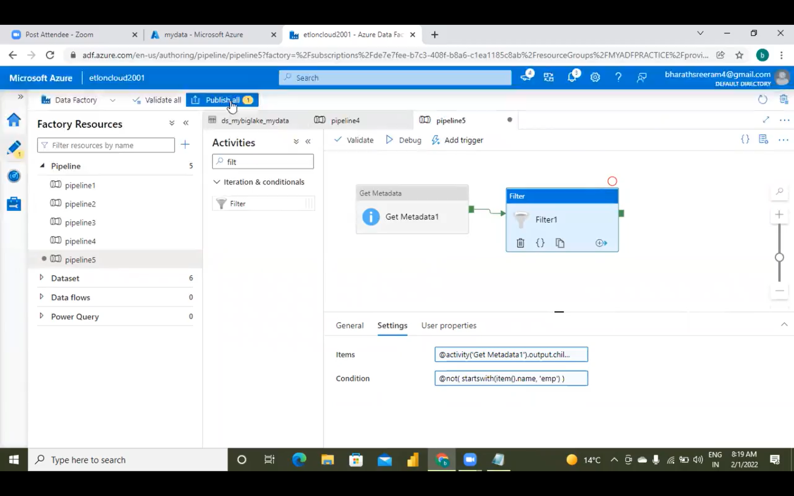
@not(
startswith(item().name, ‘emp’)
)

Slide 3
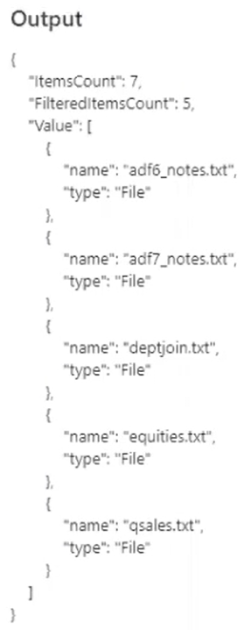

Slide 4
2) File name should start with “e” and file name should end with “.csv”

Slide 5
@and(
startswith(item().name, ‘e’),
endswith(item().name, ‘.csv’)
)

Slide 6
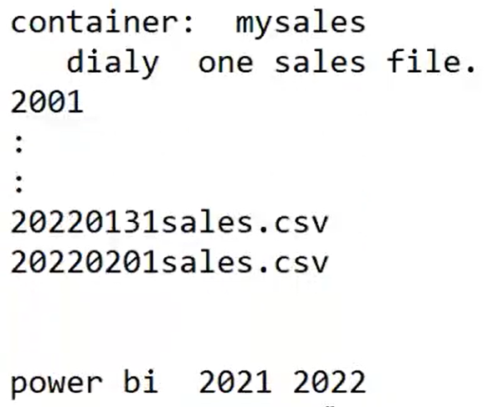
3)

Slide 7
@or(
startswith(item().name, ‘2021’),
startswith(item().name, ‘2022’)
)
@or(
endswith(item().name, ‘.csv’),
endswith(item().name, ‘.txt’)
)

Slide 8
4) How to filter only files?

Slide 9
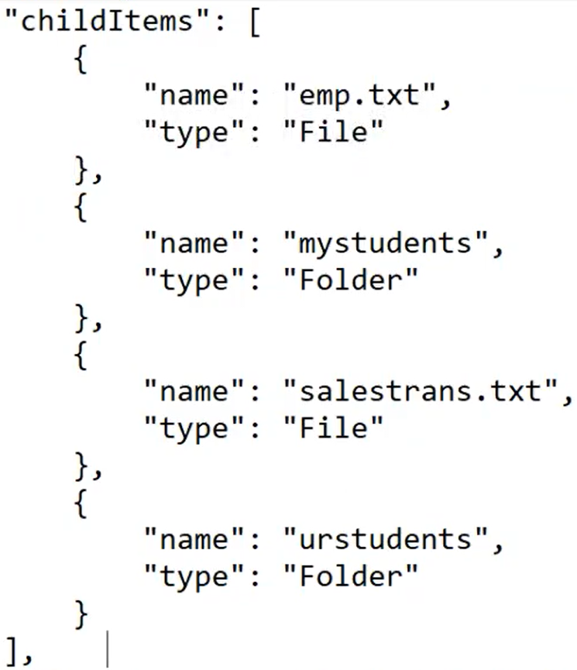

Slide 10
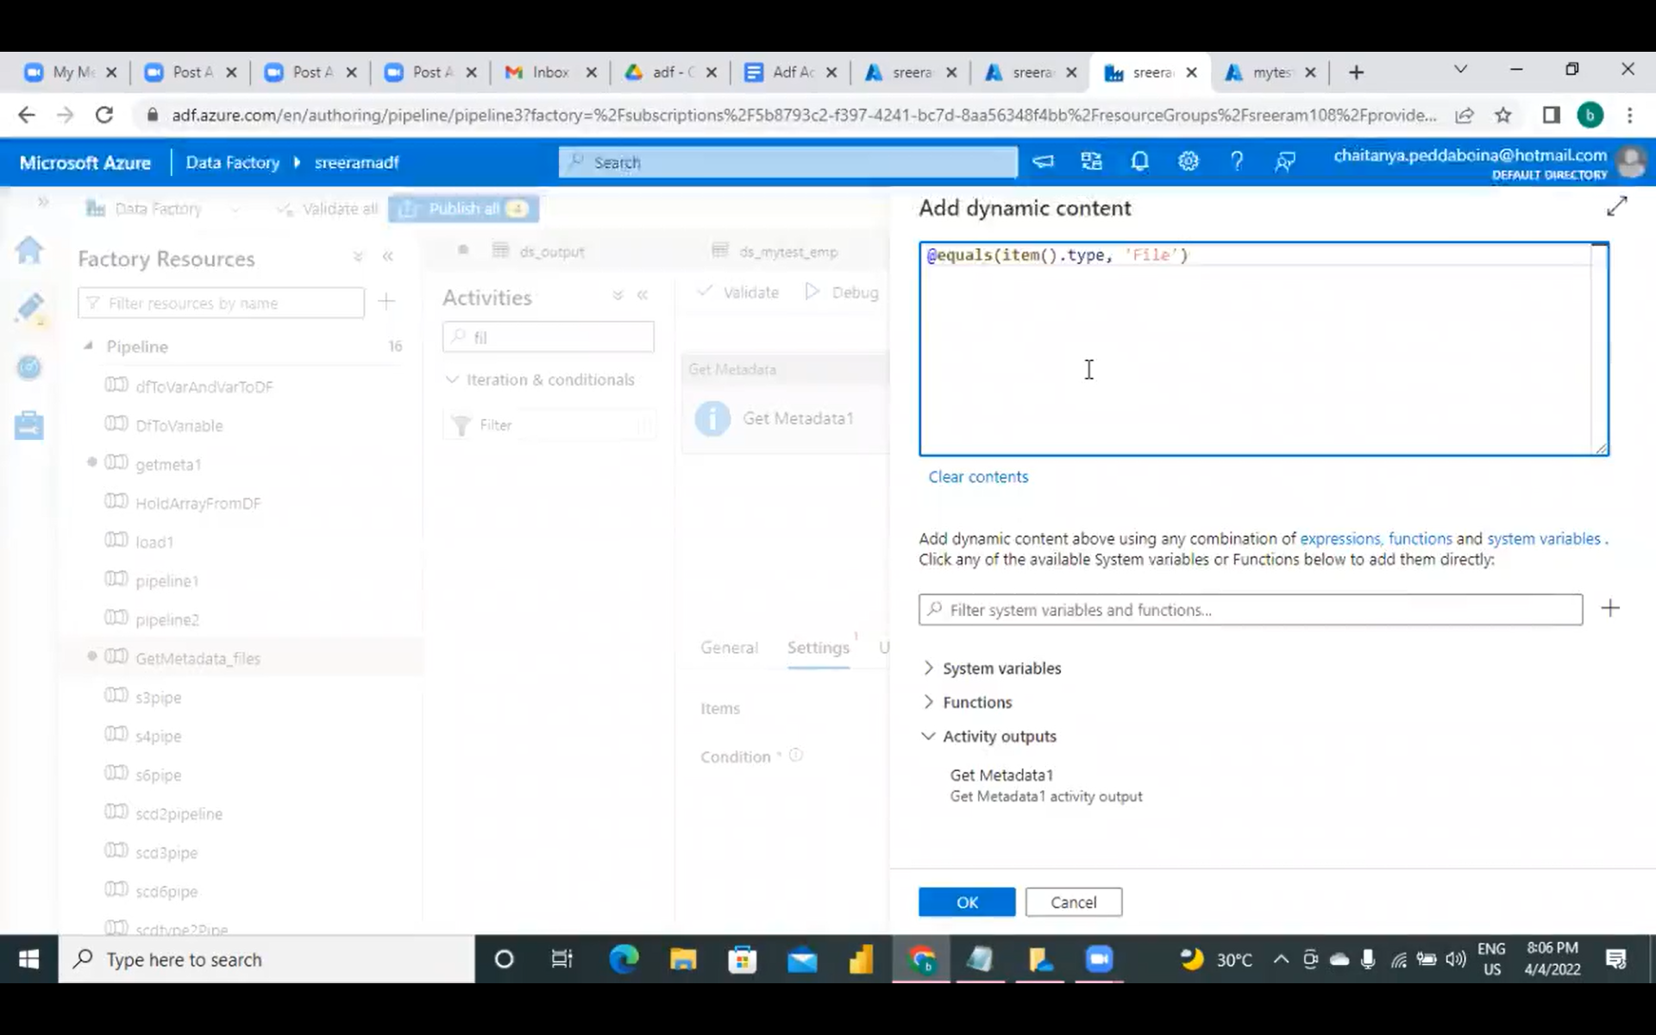
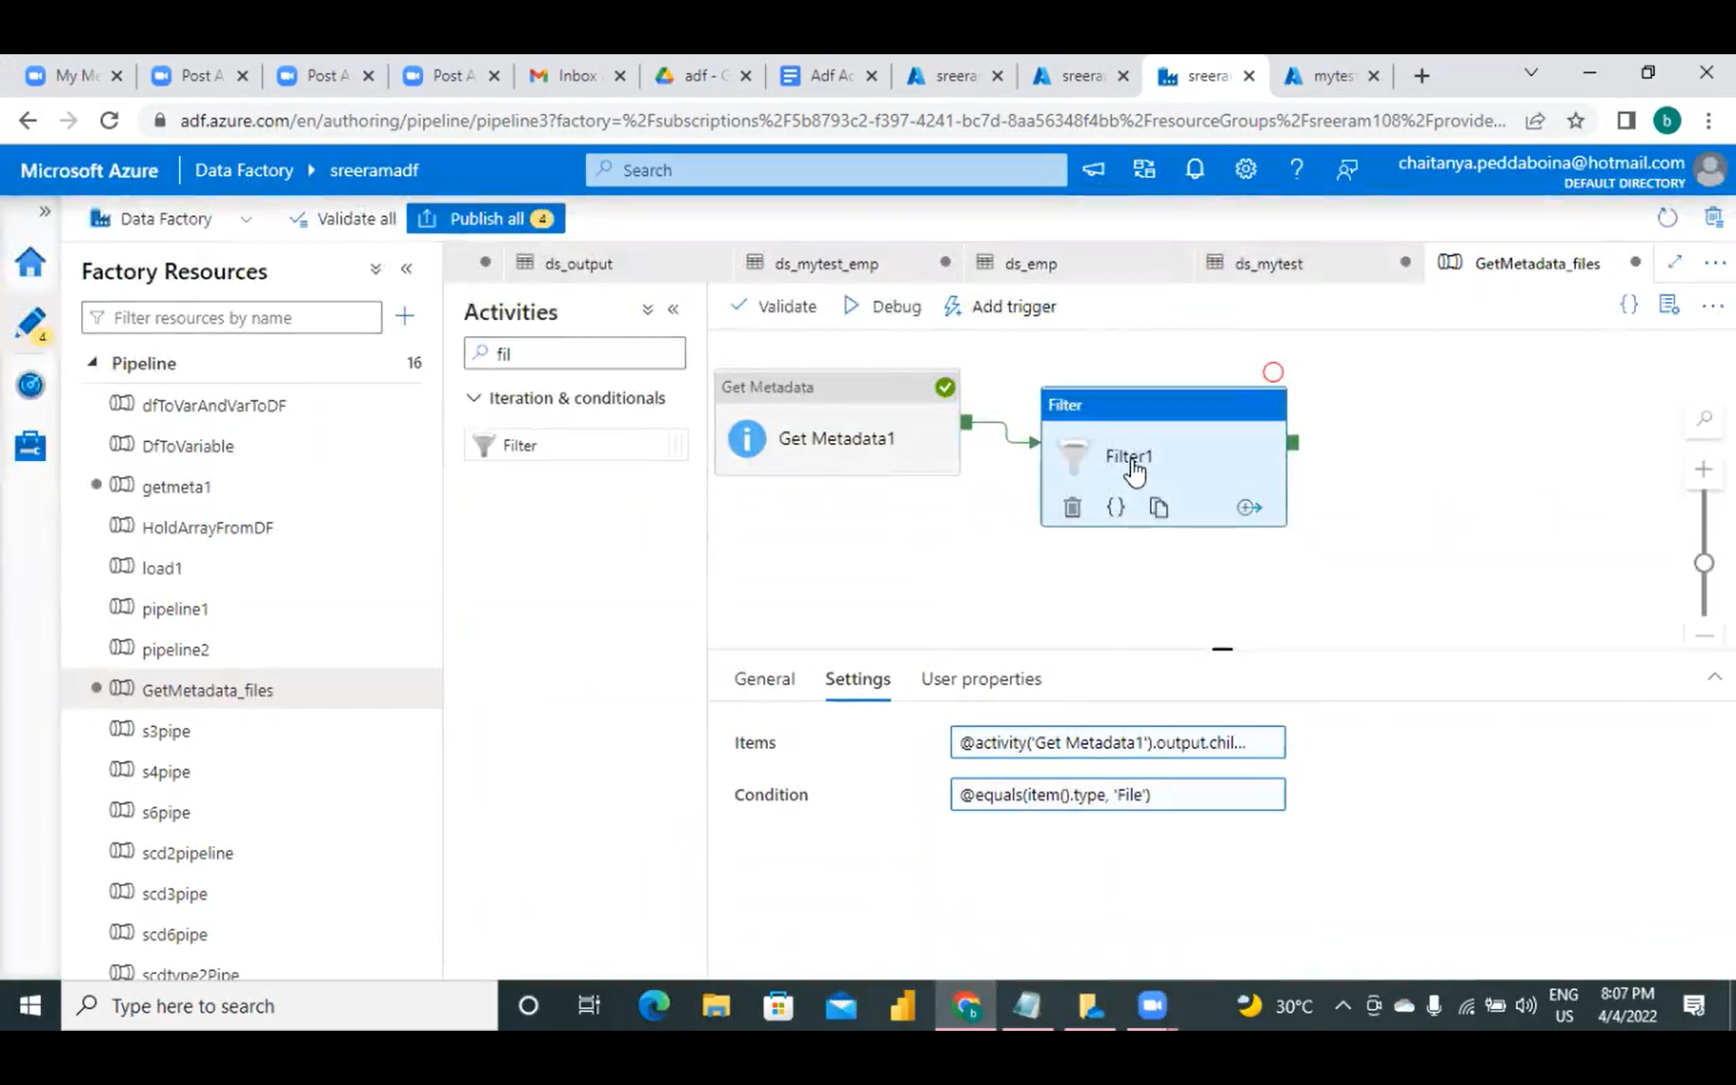
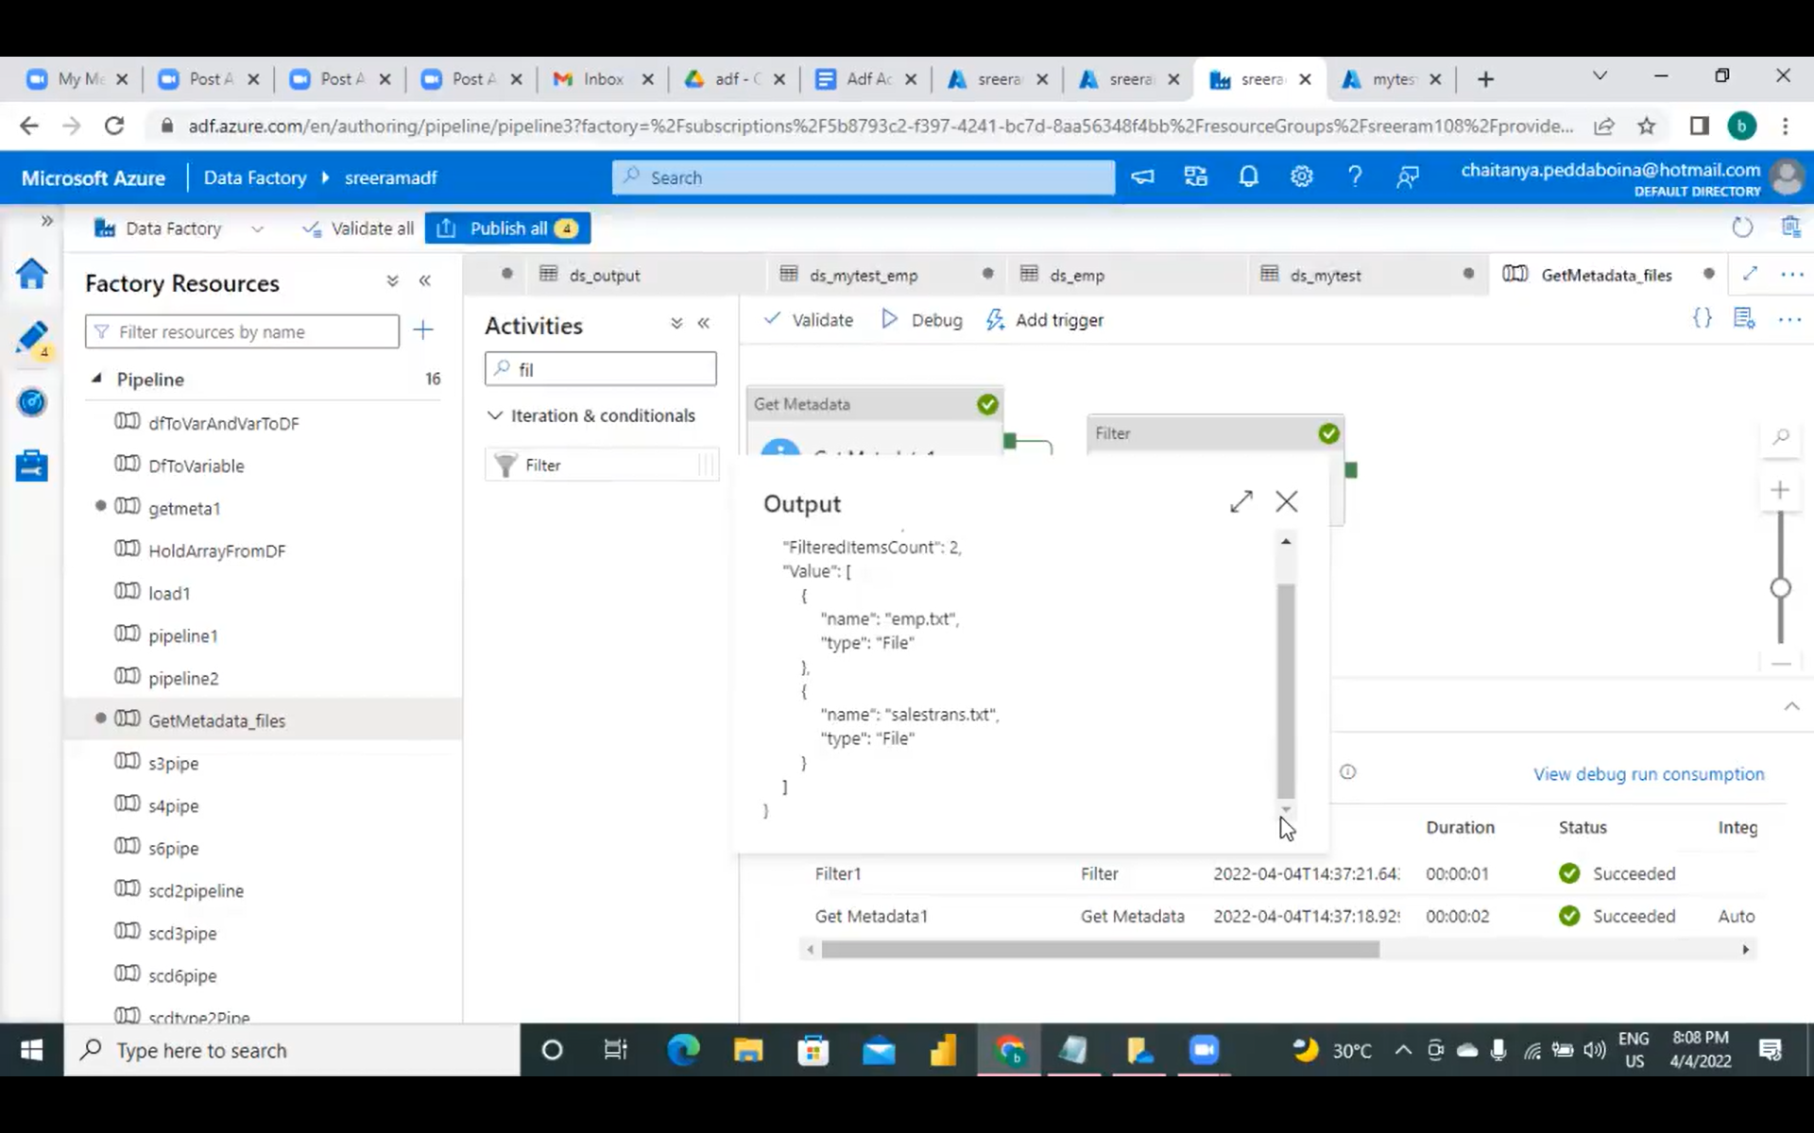
@equals(item().type, ‘File’)

Slide 12
